Slide 1
Tello Logic Backplane PCB Route/Trace Guideline
Name, Authors, details
Date

Slide 2
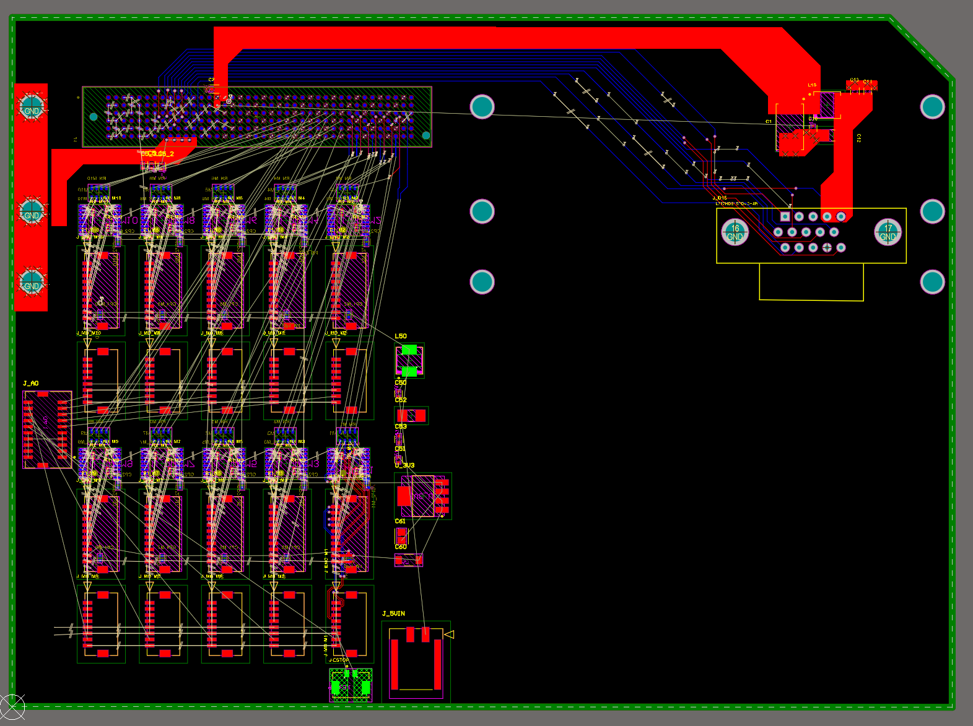
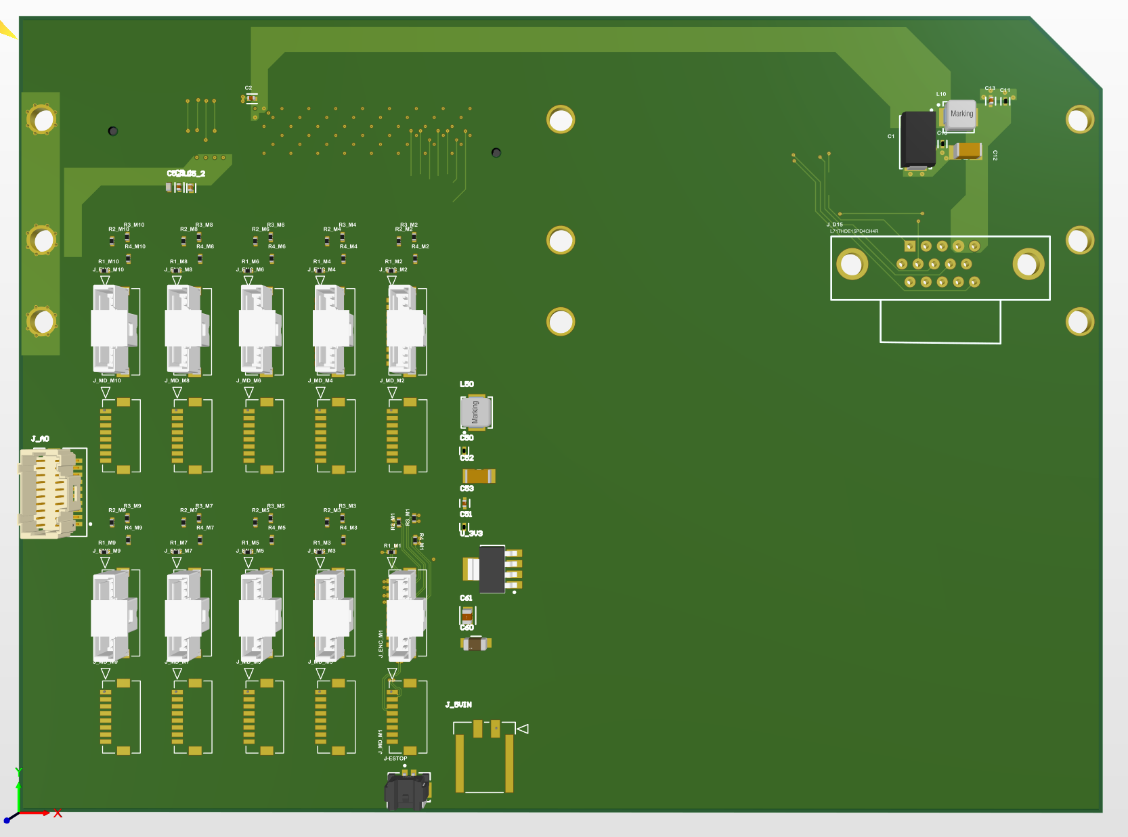
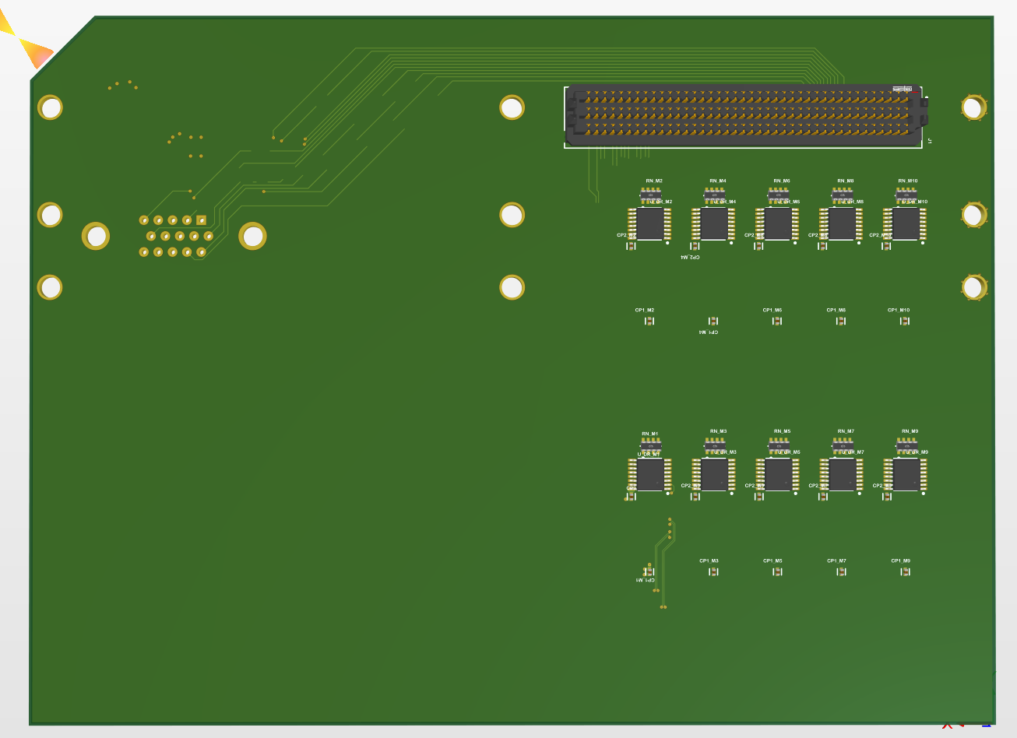
Overview

Slide 3
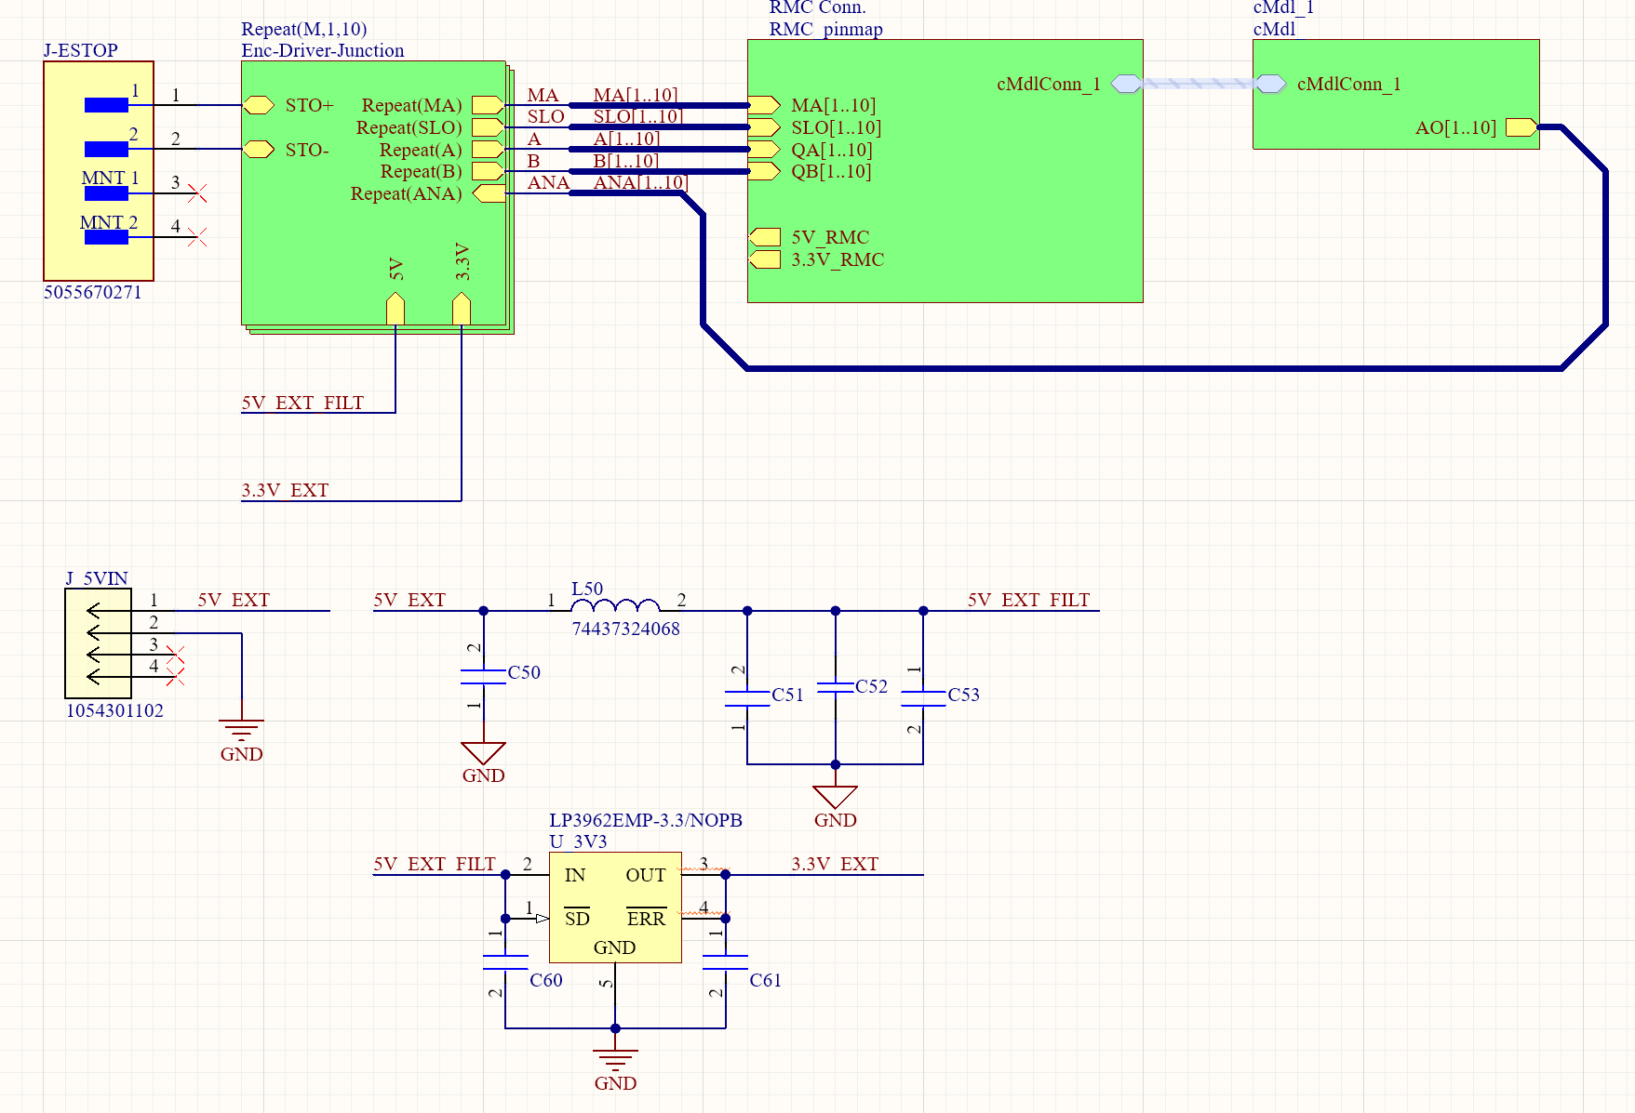
10 x Enc/MotorDrv/ AO/E-stop
Interface
RMC 240 Pins
Input: BiSS-C / Quadrature
Output: 1.5A@5V , 0.33A@3.3V
NI-9264 C-module
Analog Output
E-Stop
Molex
5055670271
← Analog Output Back to PCB←
Wurth Electronics
74437324068
6.8uH
5V Filter
Some mlcc??
External 5V In
Molex
1054301102
Some mlcc’s
3.3V LDO Reg.
LP3962EMP-3.3/NOPB
*Refer to Datasheet!
Schematic Overview
X5R 68uF
X5R 33uF

Slide 4
5
1
4
5
6
4
6
7
3
C Series Module
Analog Out
2
3
1
2
7
PCB Overview

Slide 5
5
E stop
(jumper pins)
Connectors/
Line Receivers..
FPGA Pins
C-module pwr/conn,,
C-Series Module
FPGA Pins
C-module pwr/conn,,
1
4
5
6
4
Connectors/
Line Receivers..
6
7
Analog
Singal In
3
6
External
5V input
Analog Output
Feed into pcb
C Series Module
Analog Out
5V filter + 3.3V Reg.
2
3
5V filter + 3.3V Reg.
1
2
E stop
(jumper pins)
External
5V input
7
PCB Overview

Slide 6
External Power
Power Direction
5V, 3.3V
Power Direction
5V, 3.3V
5V filter + 3.3V Reg.
External 5V input supplies 5V to encoders.
Line receivers (on the bottom layer) need 3.3V.

Slide 7
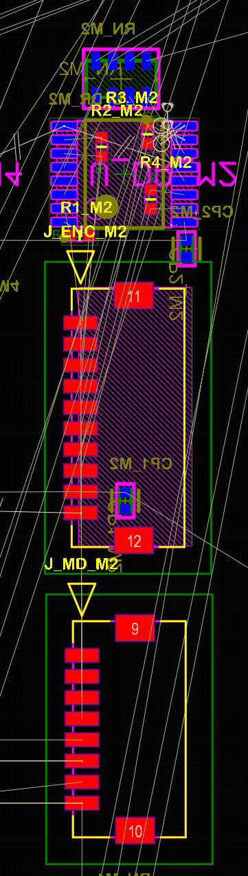
Interface Overview
FPGA Pins
SE(A/B/MA/SLO)
Line Receiver
3.3V for line receivers
BiSS-C Encoder
Diff(A/B/MA/SLO)
Filtered external 5V
5VDC
Diff(A/B/MA/SLO)
Motor Driver
AO/AGND
C-Series Module Output

Slide 8
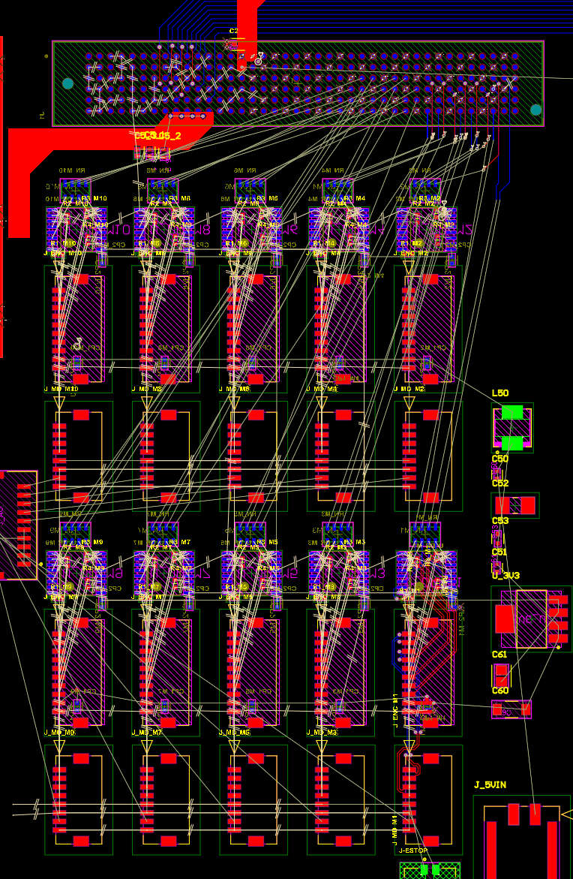
Interface Overview
FPGA Pins
Line Receiver
BiSS-C Encoder Connector
Interface
Array (10)
Motor Driver Connector

Slide 9
FPGA DIO
Encoder Feedback

Slide 10
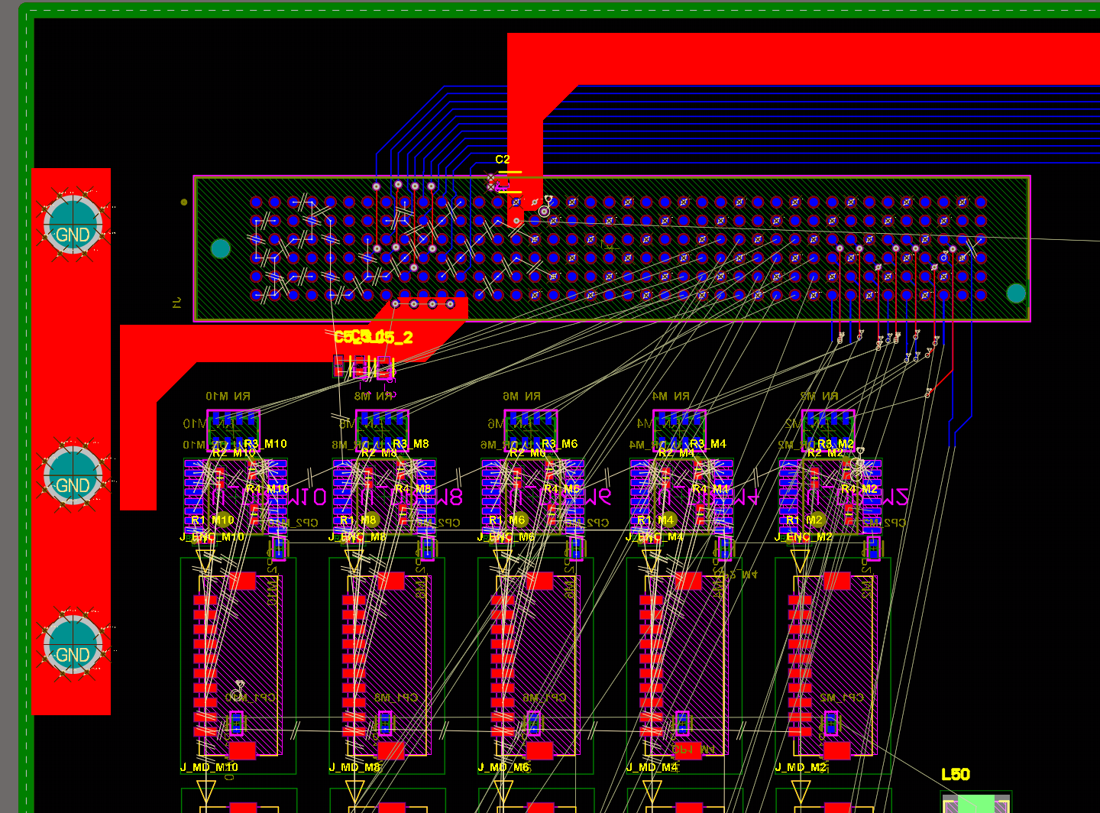
FPGA Pinmap Overview
SEARAY Header is placed on Bottom Layer
P1
P235
P6
Row1
Row6
P240

Slide 11
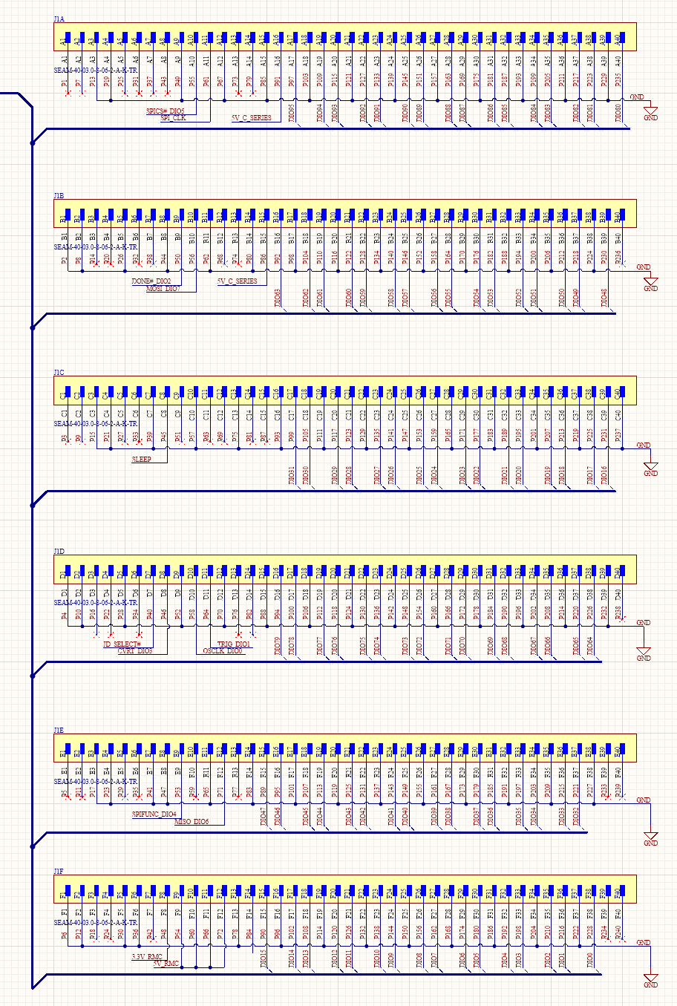
Row 1, Pin (1+6n)
FPGA Pinmap Regions
DIO
P1
P235
DIO80~95
Row 2, Pin (2+6n)
P2
P236
DIO48~63
Each row contains 16 DIO’s.
NI’s design guide’s pin order differs from manufacturer’s schematic symbol follow this ppt’s ordering
DIO16~31
DIO64~79
P5
DIO32~47
Row 6, Pin (6+6n)
P6
P260
DIO0~15

Slide 12
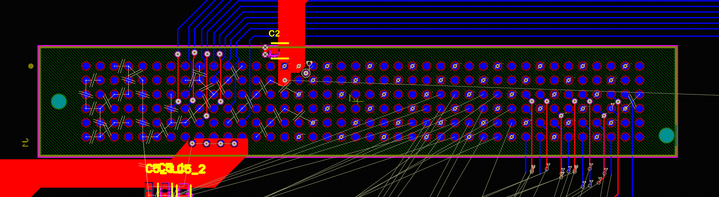
Row 1, Pin (1+6n)
FPGA Pinmap Regions
DIO
P1
P235
DIO80~95
Row 2, Pin (2+6n)
P2
P236
DIO48~63
DIO16~31
P1
DIO Bank
P235
DIO64~79
P6
P260
P5
DIO32~47
Row 6, Pin (6+6n)
P6
P260
DIO0~15

Slide 13
Encoder Feedback Pinmap
DIO’s of bottom 4 rows will read encoder feedbacks (A/B/MA/SLO)
4 types of signals → 4 rows are used
10x DIOs of each rows will be used for encoder feedbacks
Row 3
Quadrature A
DIO16~31
Row 4
Quadrature B
DIO64~79
Row3
Encoder Feedback
Row6
Row 5
BiSS-C MA
DIO32~47
Row 6
BiSS-C SLO
DIO0~15

Slide 14
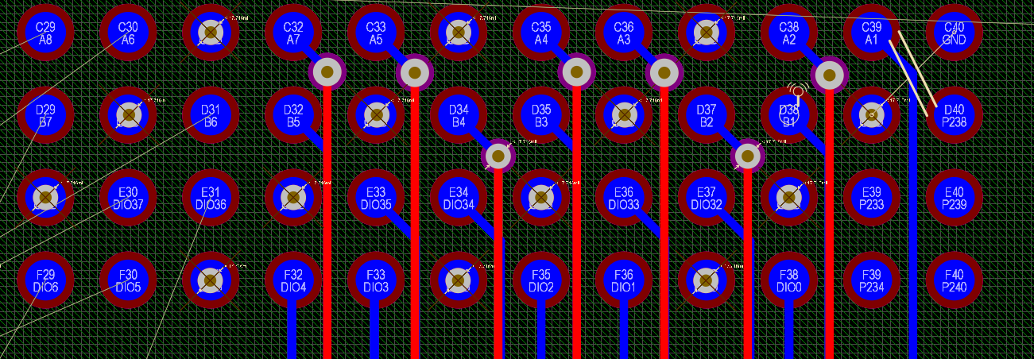
Encoder feedback routing – More visuals
SEARAY Header is placed on Bottom Layer
SEARAY Header is placed on Bottom Layer
P1
P235
Wiring of encoder feedbacks to FPGA pins
P6
Row 1 (Pin 6n+1)
Row 2 (Pin 6n+2)
Row 6 (Pin 6n+6)
P240
Row 3, DIO16~25 = Quadrature A
Row 4, DIO64~73 = Quadrature B
Row 5, DIO32~41 = BiSS-C MA
Row 6, DIO0~9 = BiSS-C SLO
P240

Slide 15
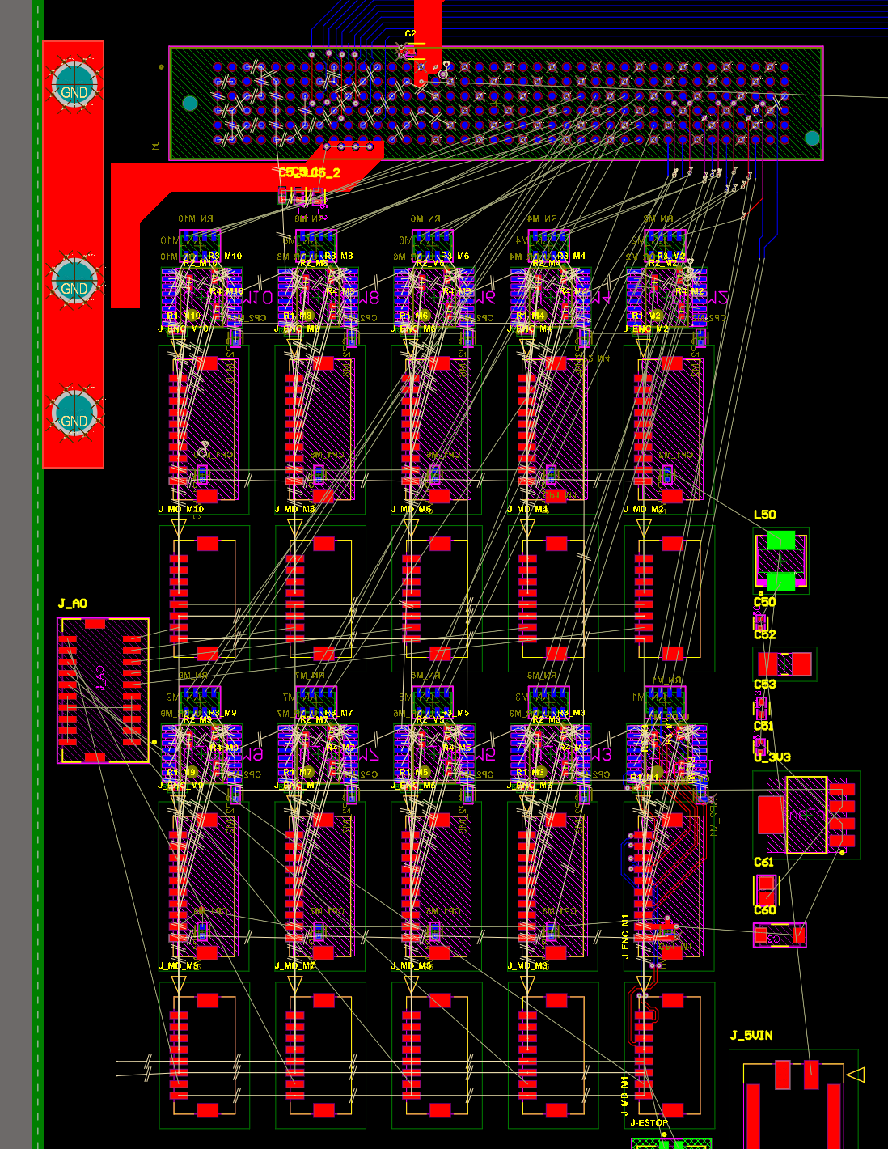
Encoder feedback routing – More visuals
Enc10
Enc1

Slide 16
FPGA DIO
C-Series Module

Slide 17
FPGA Pinmap Regions
C-Series Module
C-Module
Comm/Pwr
Some pins on the first and second row are dedicated for the control and power of C-series modules
Routing guideline for c-series module is in (mezzanine card design guide.pdf)

Slide 18
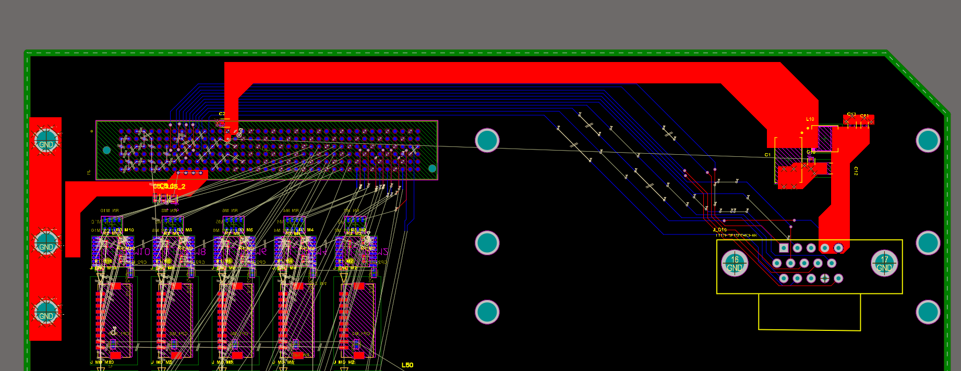
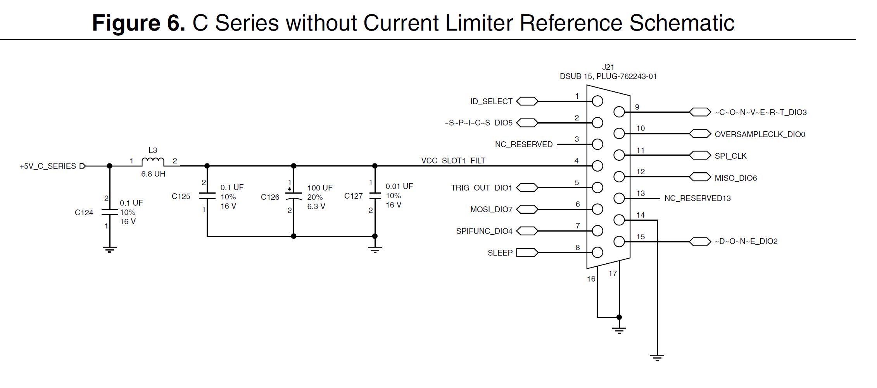
C-Series Module Routing
C-Module
Comm/Pwr Pins
Power Filter
Connector
Power Filter
Connector

Slide 19
C-Series Module’s Output Routing
C-Series module outputs analog signals (AO)
Each AO will be fed into corresponding motor driver
I’ll make a custom cable, so no need to worry about the orientation or pin orders of the connector in dashed-line-box. (picoclasp vertical 20 pos header)
C Series Module
Analog Out
7

Slide 20
FPGA DIO
More DIO Breakouts

Slide 21
FPGA DIO Breakouts
16 Unused DIO
So far, we used 10DIO x 4 row = 40 DIO pins
There are still plenty DIOs remaining 16 x 2 + 6 x 4 = 56 DIOs
16 Unused DIO
Row 3
6 Unused DIO
Row 4
6 Unused DIO
Row 5
6 Unused DIO
Row 6
6 Unused DIO

Slide 22
FPGA DIO Breakouts
Expandable Area
The remaining DIO’s can broken out in the green region. (try your best, don’t need them all)
Place as many as headers as needed (preferably IDC 2.54mm pitch header shrouded double row, 10/20 pos..)
y-length after expansion is limited to ~5200 mil (sbRIO’s y-length is 4050 mil)

Slide 23
E-Stop
Wiring

Slide 24
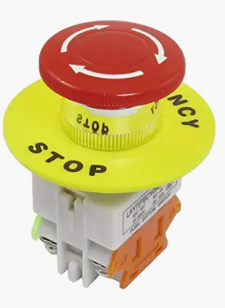
E-Stop Wiring – Satefy Torque Off
AMC
Motor
Driver
STO_RETURN_1
To enable torque on AMC drivers, two pins need be shorted. Pull down/up is already embedded, so we just need to connect the switch.
AMC_LOGIC_GND
On-off
S/W

Slide 25
E-Stop Wiring – Satefy Torque Off
short STO lines in the PCB so that one E-stop can control all drivers. (Not sure if it’s okay)
short STO’s and GND’s together
(Not sure if it’s okay)
AMC
Motor
Driver
AMC
Motor
Driver
AMC
Motor
Driver
AMC
Motor
Driver
STO’s
PCB
STO1
GND’s
STO2
On-off
S/W

Slide 26
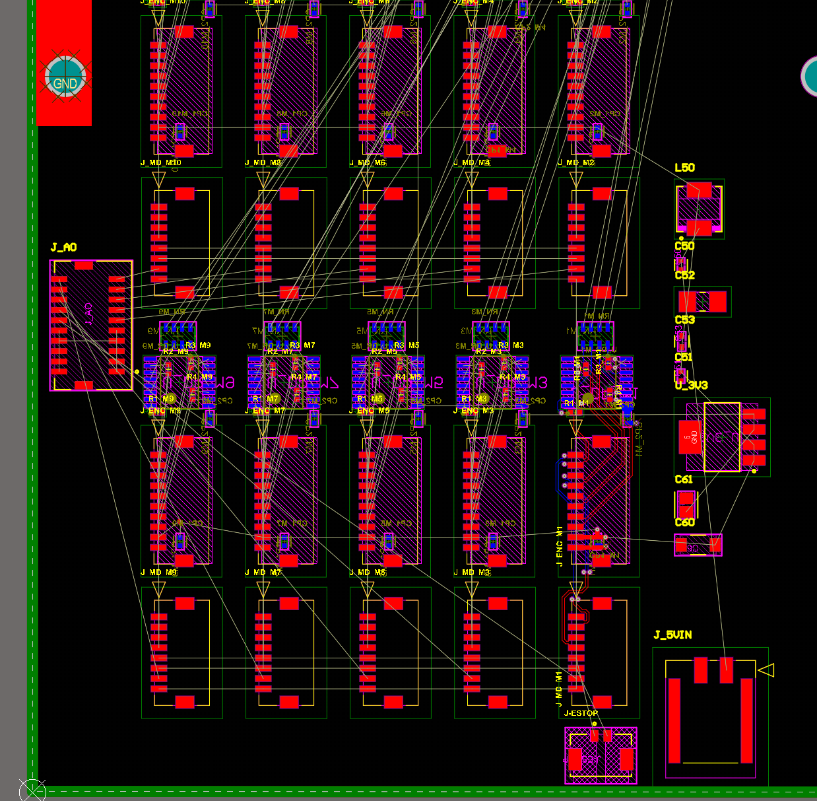
Example E-Stop Wiring

Slide 27
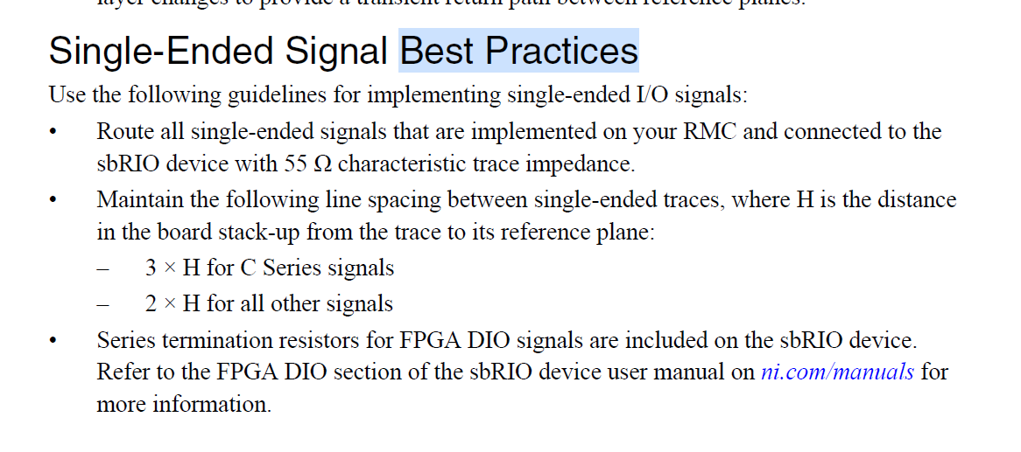
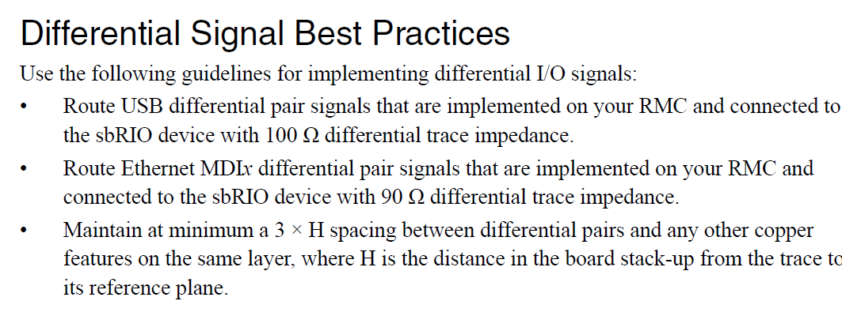
Rules
55ohm impedance for single ended circuit
Recommended design practice.

Slide 28
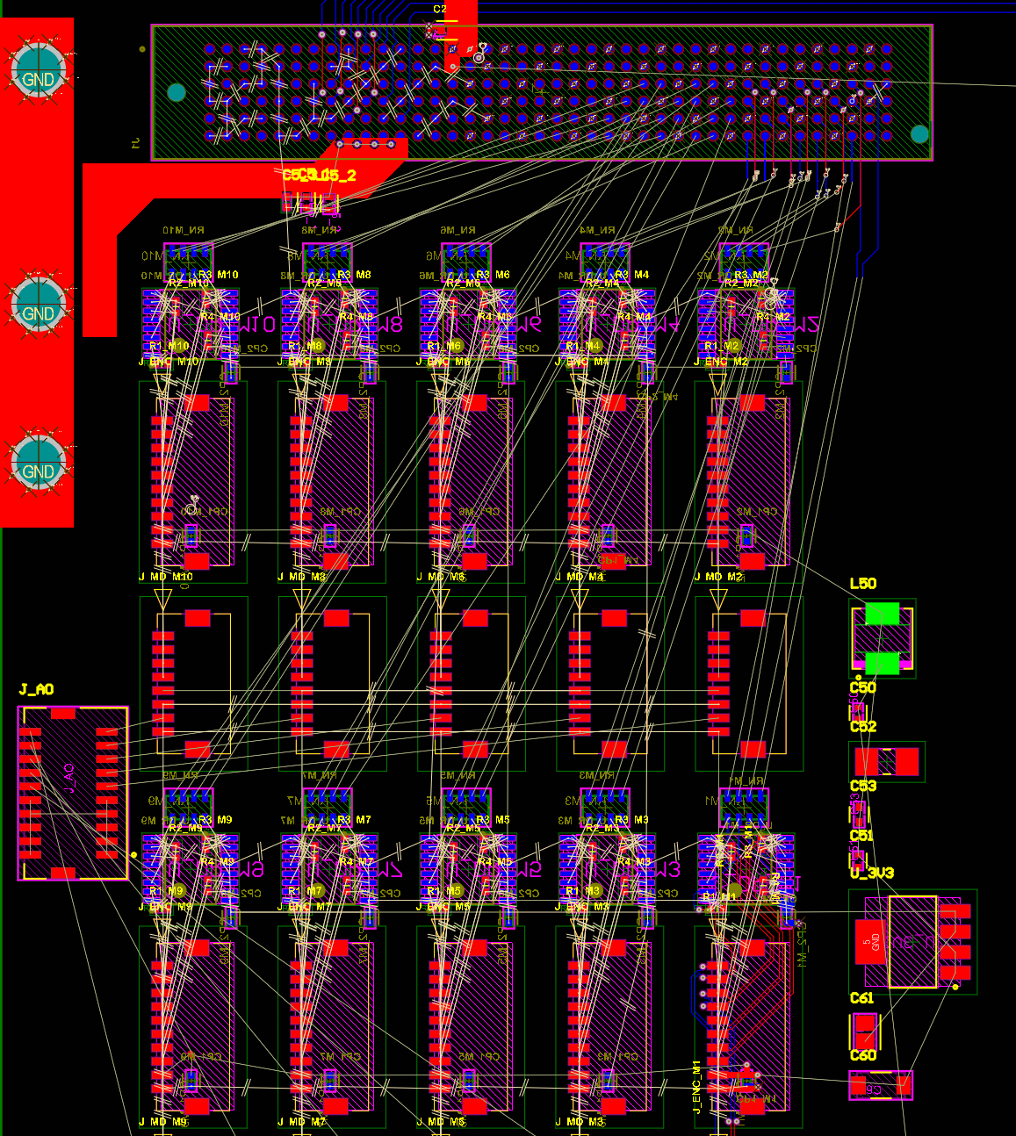
Interface Details
5V_RMC, max 1.5A
We don’t need this (lacks power)
Line Receiver + 110 ohm termination + 47ohm series termination to FPGA
*I’m not sure if I should put series termination there.
** Line receivers need 3.3V. There’s also 3.3V output from sbrio, but 0.33A max.
Connector to encoder
A/NA/B/NB/MA/NMA/SLO/NSLO/5V/GND
Connector to motor driver
MA/NMA/SLO/NSLO/AO/AGND/STO1/STO2
*AO comes from C-module
*STO1 and STO2 are jumper pins
Analog output from C-Module
Signals go directly to motor driver (reference torque)
AO1….AO10

